Slide 1


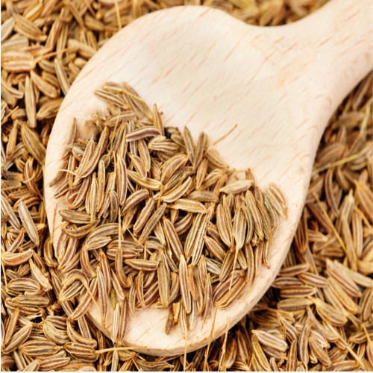
CUMIN SEED SCENARIO 2025

Slide 2
STATEWISE CUMIN AREA, YIELD & PRODUCTION
State | Estimated Area ( '000' Ha.) |  |  | Estimated Yield (Kg/Ha.) |  |  | Estimated Production ('000' MT.)
 | 2024 | 2025 | Change in (%) | 2024 | 2025 | Change in (%) | 2024 | 2025 | Change in (%)
 | Area | Area |  | Yield | Yield |  | Prod. | Prod.
Gujarat | 521.00 | 455.67 | -13% | 508 | 552 | 9% | 264.83 | 251.59 | -5%
Rajasthan | 743.20 | 716.24 | -4% | 476 | 401 | -16% | 353.51 | 287.08 | -19%
Total (Guj & Raj) | 1264.20 | 1171.91 | -7% | 489 | 460 | -6% | 618.34 | 538.67 | -13%
Overall area covered under cumin seed in Gujarat & Rajasthan state has decreased by 7% over last year.
Average yields is lower by 6% from last year.
On account of lower area and yields cumin production in Gujarat & Rajasthan state is lower by 13% from last year.

Slide 3
STATEWISE CUMIN SEED PODUCTION IN 55KG BAGS
State | Estimated Production (in 55Kg Bags)
 | 2024 | 2025 | Absolute Change
Gujarat | 48,15,000 | 45,74,334 | -2,40,666
Rajasthan | 64,27,509 | 52,19,584 | -12,07,926
Total | 1,12,42,509 | 97,93,917 | -14,48,592
To sum up with this year Cumin Seed Production is lower by around 14,48,592 Bags over last year.

Slide 4

504, APMC Building Market Yard,
Unjha- 381470,
GUJARAT
INDIA
Ph No : +919173137161
Email: info@fissh.org
Web: www.fissh.org

