Slide 1


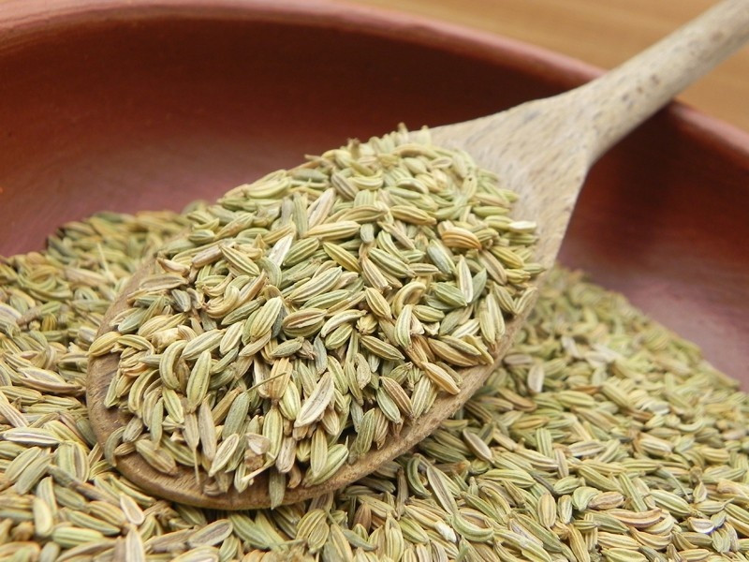
FENNEL SEED SCENARIO 2025

Slide 2
STATEWISE FENNEL AREA, YIELD & PRODUCTION
State | Estimated Area ('000' Ha.) |  |  | Estimated Yield (Kg/Ha.) |  |  | Estimated Production ('000' MT.)
 | 2024 | 2025 | Change in (%) | 2024 | 2025 | Change in (%) | 2024 | 2025 | Change in (%)
 | Area | Area |  | Yield | Yield |  | Prod. | Prod.
Gujarat | 123.66 | 45.28 | -63% | 1058 | 1136 | 7% | 130.84 | 51.44 | -61%
Rajasthan | 58.85 | 38.22 | -35% | 1141 | 1132 | -1% | 67.12 | 43.27 | -36%
Others (MP&UP) | 14.50 | 8.70 | -40% | 985 | 925 | -6% | 14.28 | 8.05 | -44%
Total | 197.00 | 92.20 | -53% | 1077 | 1115 | 3% | 212.24 | 102.76 | -52%
All India area covered under Fennel seed has decreased by 53% over last year.
Overall average yields are showing a increased by 3% from last year.
Production has lower by 52% this year due other crop shifting compared to the previous year.

Slide 3
ALL INDIA STATEWISE FENNEL SEED PRODUCTION IN 55KG BAGS
State | Estimated Production ((in 55Kg Bags)
 | 2024 | 2025 | Absolute Change
Gujarat | 23,78,868 | 9,35,298 | -14,43,570
Rajasthan | 12,20,409 | 7,86,777 | -4,33,632
Others (MP&UP) | 2,59,682 | 1,46,318 | -1,13,364
Total | 38,58,959 | 18,68,393 | -19,90,566
To sum up with this year all India Fennel seed production is lower by around 19,90,566 bags over last year.

Slide 4

504, APMC Building Market Yard,
Unjha- 381470,
GUJARAT
INDIA
Ph No : 7575012828/7575012424
Email: info@fissh.org
Web: www.fissh.org

