Slide 1



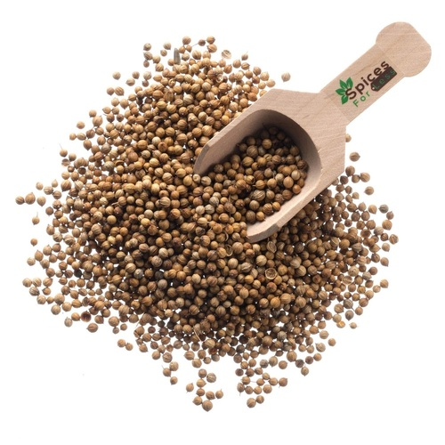
CORIANDER SEED SCENARIO 2025

Slide 2
STATEWISE CORIANDER AREA, YIELD & PRODUCTION
State | Estimated Area ('000' Ha.) |  |  | Estimated Yield (Kg/Ha.) |  |  | Estimated Production ('000' MT.)
 | 2024 | 2025 | Change in (%) | 2024 | 2025 | Change in (%) | 2024 | 2025 | Change in (%)
 | Area | Area |  | Yield | Yield |  | Prod. | Prod.
Madhya Pradesh | 188.80 | 162.00 | -14.2% | 1279 | 1310 | 2.4% | 241.45 | 212.24 | -12.1%
Rajasthan | 50.06 | 47.05 | -6.0% | 1280 | 1308 | 2.2% | 64.08 | 61.54 | -4.0%
Gujarat | 125.41 | 128.40 | 2.4% | 1263 | 1313 | 3.9% | 158.35 | 168.53 | 6.4%
Total | 364.27 | 337.45 | -7.4% | 1273 | 1311 | 2.9% | 463.88 | 442.31 | -4.6%
The total area under coriander has decreased by 7.4% as compared to last year.
The overall average yield is marginally higher than last year.
Due to less area, coriander production has decreased by 4.6% as compared to last year.

Slide 3
STATEWISE CORIANDER SEED PODUCTION IN 40KG BAGS
State | Estimated Production (In 40kg Bags)
 | 2024 | 2025 | Absolute Change
Madhya Pradesh | 60,36,231 | 53,06,019 | -7,30,212
Rajasthan | 16,01,895 | 15,38,588 | -63,308
Gujarat | 39,58,776 | 42,13,163 | 2,54,387
Total | 1,15,96,901 | 1,10,57,769 | -5,39,133
To sum up with this year Coriander Seed Production is lower by around 5,39,133 Bags over last year.

Slide 4

504, APMC Building Market Yard,
Unjha- 381470,
GUJARAT
INDIA
Ph No : 7575012828/7575012424
Email: info@fissh.org
Web: www.fissh.org

