Slide 1


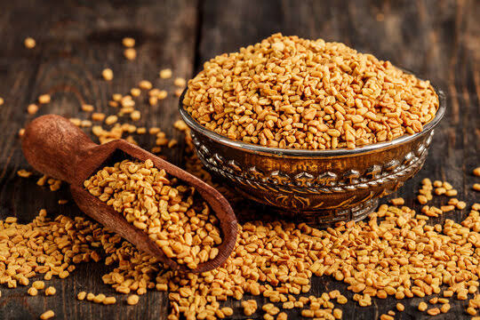
FENUGREEK SCENARIO 2025

Slide 2
STATEWISE FENUGREEK AREA, YIELD & PRODUCTION
State | Estimated Area ('000' Ha.) |  |  | Estimated Yield (Kg/Ha.) |  |  | Estimated Production ('000' MT.)
 | 2024 | 2025 | Change in (%) | 2024 | 2025 | Change in (%) | 2024 | 2025 | Change in (%)
 | Area | Area |  | Yield | Yield |  | Prod. | Prod.
Rajasthan | 42.95 | 47.45 | 10% | 1219 | 1285 | 5% | 52.38 | 60.96 | 16%
Madhya Pradesh | 67.39 | 64.09 | -5% | 1322 | 1325 | 0% | 89.10 | 84.92 | -5%
Gujarat | 17.97 | 18.60 | 4% | 1370 | 1385 | 1% | 24.62 | 25.76 | 5%
Total | 128.31 | 130.14 | 1% | 1295 | 1319 | 2% | 166.09 | 171.64 | 3%
Overall area covered under Fenugreek in all the three states has increased by 1% over last year.
Overall average yields are marginally increased from last year.
On account of marginally increased area & yield Fenugreek production increased by 3% over last year.

Slide 3
STATEWISE FENUGREEK PODUCTION IN 100KG BAGS
State | Estimated Production (in 100Kg Bags)
 | 2024 | 2025 | Absolute Change
Rajasthan | 5,23,755 | 6,09,560 | 85,805
Madhya Pradesh | 8,90,977 | 8,49,230 | -41,747
Gujarat | 2,46,189 | 2,57,610 | 11,421
Total | 16,60,920 | 17,16,400 | 55,479
To sum up with this year Fenugreek Production is higher by around 55,479 Bags over last year.

Slide 4

504, APMC Building Market Yard,
Unjha- 381470,
GUJARAT
INDIA
Ph No : 7575012828/7575012424
Email: info@fissh.org
Web: www.fissh.org

